Slide 1
Week 5 AERO 222 Lab
Newton’s Method and Convergence Criteria

Slide 2
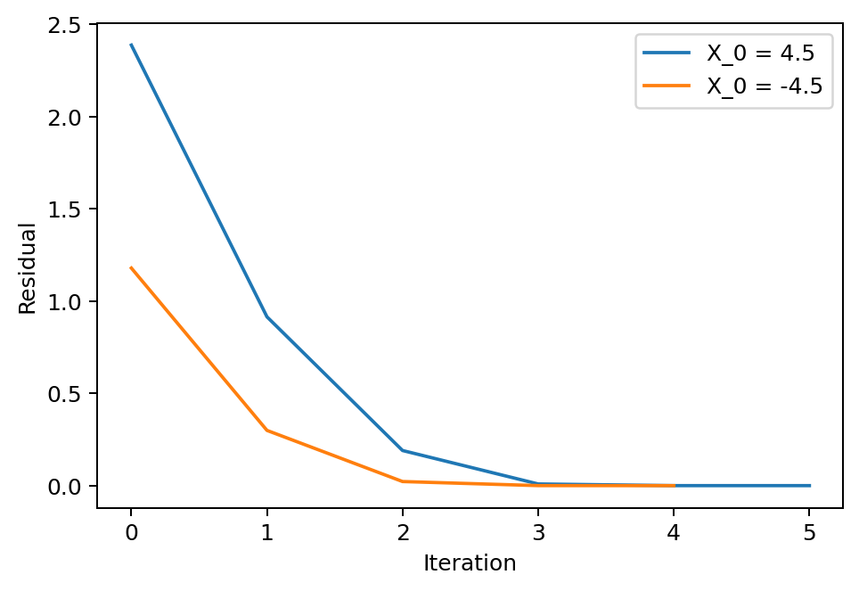
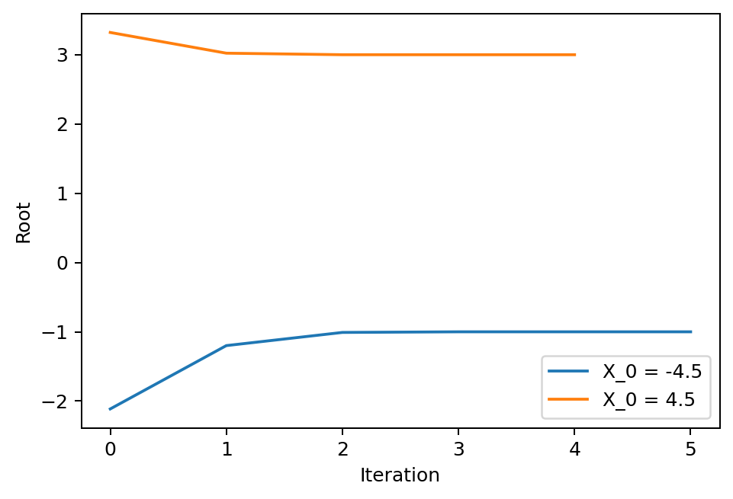
Problem Assignment
Given the equation f(x) = x^2 – 2x – 3:
Write a function to determine the slope f’(x) using a finite differences method
Find the roots using Newton’s method
Set x0 = 4.5 and find the solution
Then set x0 = -4.5 and find the solution
Set ϵ = 0.00001
How does convergence change if we calculate convergence based on error vs residual? (as outlined in slide 5)

Slide 3
Example 2: the Taylor series
What? Estimate the function in a position different from where we know the value of the function and (at least one) derivative

Slide 4
Newton’s Method
Taylor expansion explanation

Slide 5








Error and Residual
Problem: Solve for x such that f (x) = 0.
$$f(x)$$
Error
$$ε_{x}=\left|x −\hat{x}\right|$$
Residual
$$f(\hat{x})$$
$$ε_{y}=\left|f(\hat{x})\right|$$
$$x$$
$$f\left(x\right)=0$$
$$\hat{x}$$
$$x$$

Slide 6
Define your equations as functions
Test them out, make sure they return the correct values
Initialize your lists
Includes anything you need to track or plot
Determine your iterative
What error or an independent variable are you trying to converge?
Iterate to your solution
Keep track of which variables are inside your loop
What types of values are they?
Are you overwriting any values you need later?
End when stopping criteria is met
Plot your solution
Matplotlib.pyplot.plt
plt.plot(xList, yList (optional)) is the simplest plot
For logarithmic axis:
plt.loglog() plots both axis as log scale, plt.semilogx() plots the x axis as log scale, plt.semilogy() plots the y axis as log scale
Other tips:
Defined functions only track their specified inputs and outputs
If you redefine a variable later in your main script, it will not remember the previous value
If you redefine a single value in a list or array, it will update the array and keep the other array values
If you append a list, it will add the value to the end of the list
Use brackets for indices, parenthesis for calling functions and (if necessary) grouping/order of operations
Parenthesis immediately after a word will likely be treated as a function call
Square brackets immediately after a word will likely be treated as the index of a list or matrix
Someone, somewhere has probably run into the same problem before
Googling your errors or problems is a legitimate way to find programming solutions

